Slide 1
Software Presentation
Pomodoro timer
Elena Pajares - HCI

Slide 2
Index
02
04
project
implement.
Mistakes
Future
01
03

Slide 3
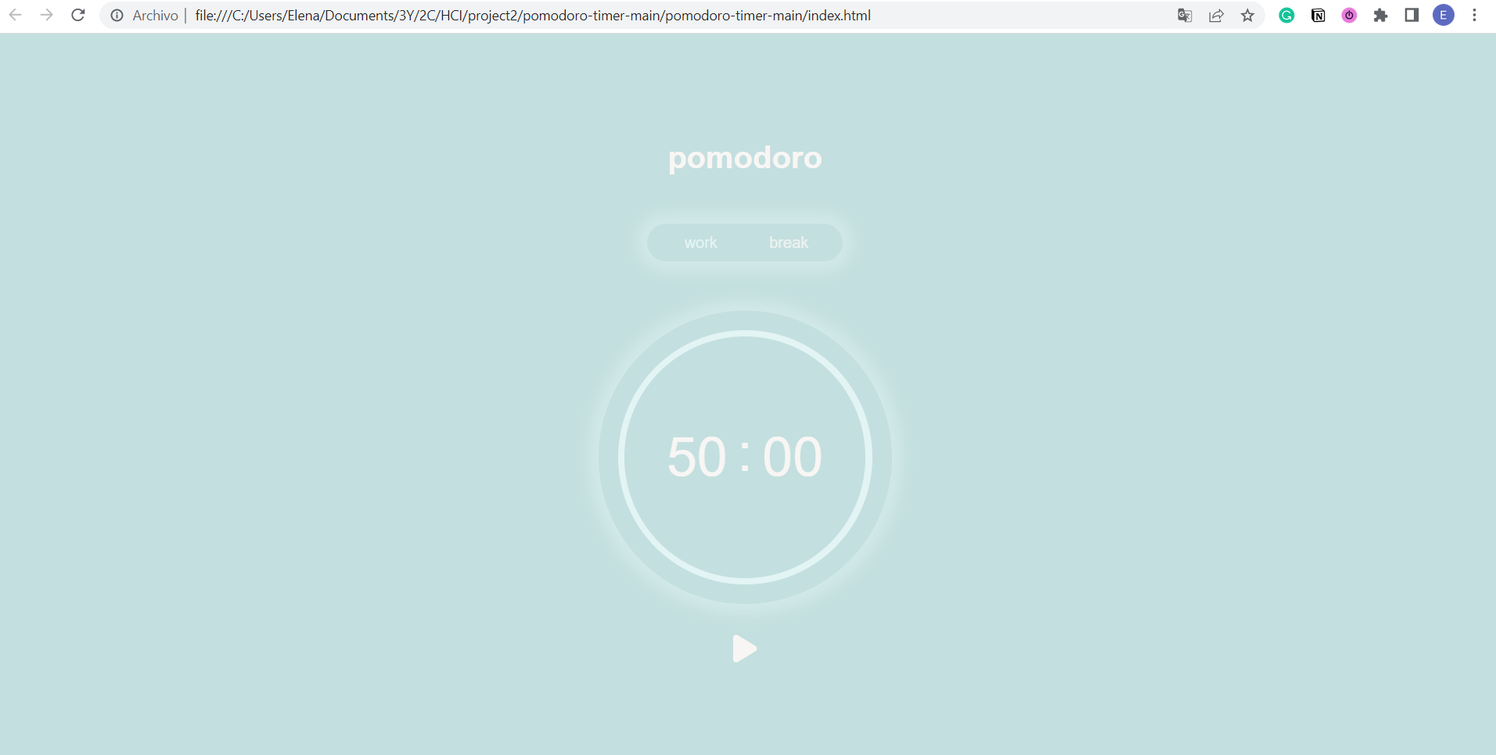
PROJECT
Pomodoro Study Timer with integrated rewards

Slide 4
Implementation
HTML
Basic Structure
Structure
CSS
Style elements
JavaScript
Functional Implementation

Slide 5
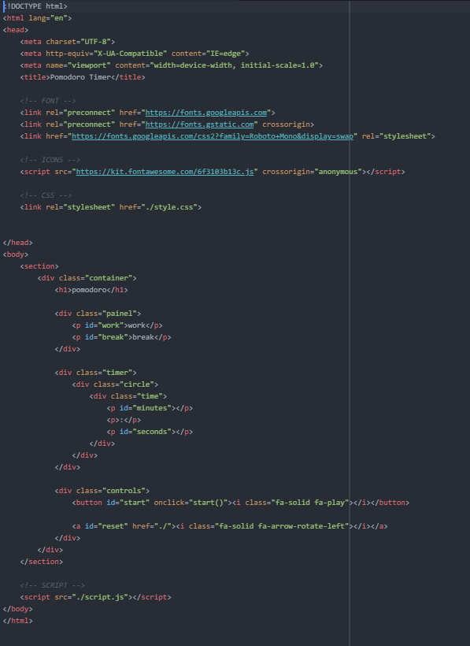
HTML

Slide 6
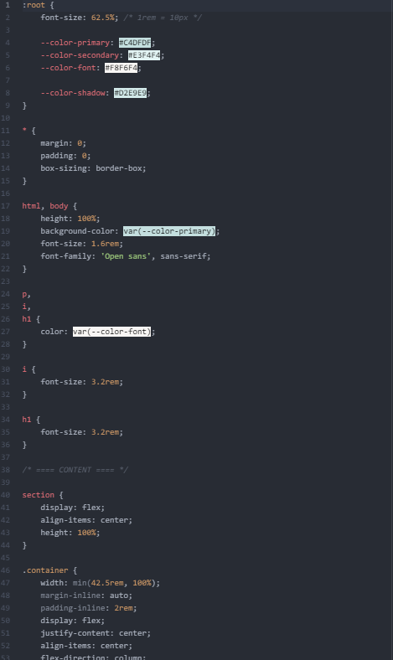
CSS

Slide 7
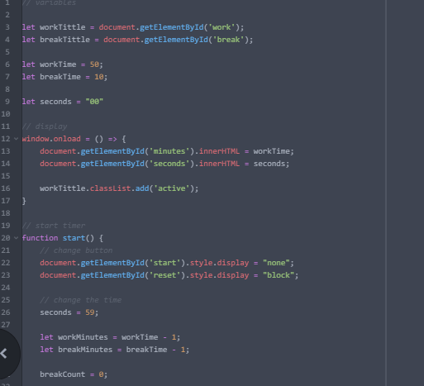
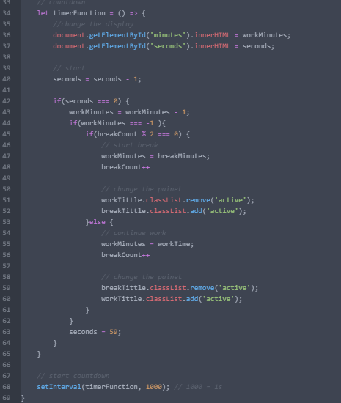
JS

Slide 8
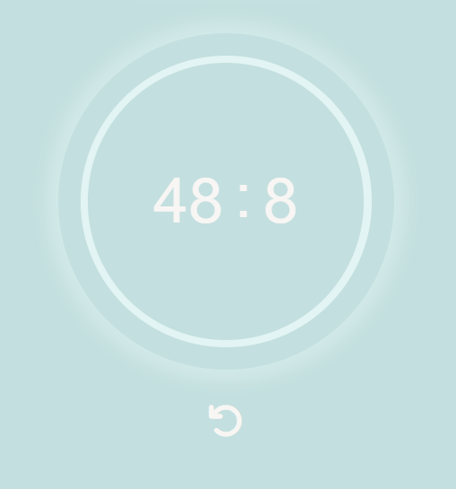
ERRORS

Slide 9
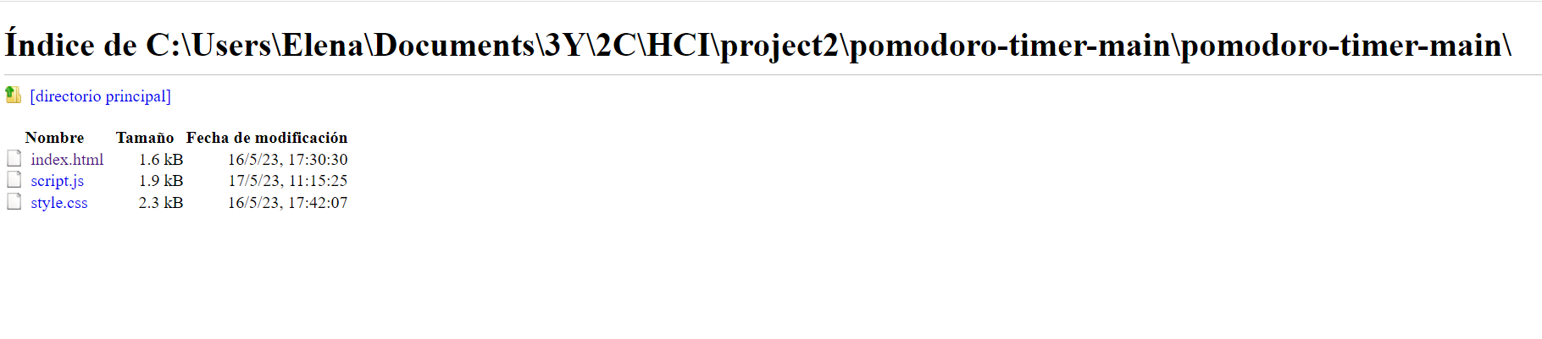
ERRORS

Slide 10
FUTURE additions
PROPOSALS
rewards
COLORS
errors
progress
Implement the rewards system
Change color scheme to make it more clear
Deploy errors
Add a way to show the progress in the timer

Slide 11
THANK YOU!

